Slide 1
22C:19 Discrete Structures Induction and Recursion
Spring 2014
Sukumar Ghosh

Slide 2
What is mathematical induction?
It is a method of proving that something holds.
Suppose we have an infinite ladder, and we want to know
if we can reach every step on this ladder.
We know the following two things:
We can reach the base of the ladder
If we can reach a particular step, then we can reach the
next step
Can we conclude that we can reach every step of the ladder?

Slide 3
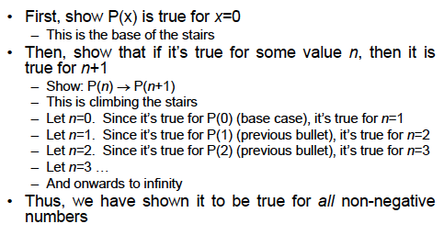
Understanding induction
Suppose we want to prove that P(x) holds for all x

Slide 4
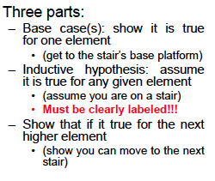
Proof structure

Slide 5
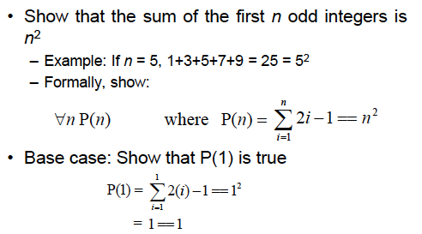
Example 1

Slide 6
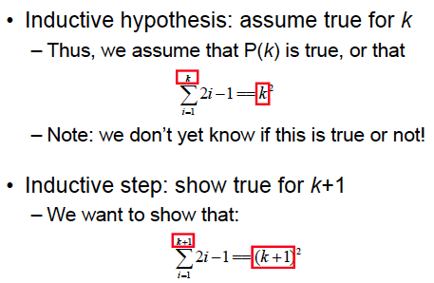
Example continued

Slide 7
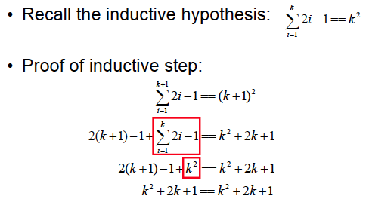
Example continued

Slide 8
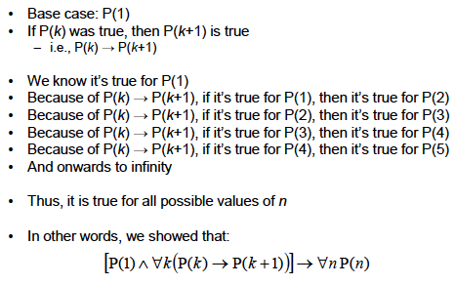
What did we show?

Slide 9
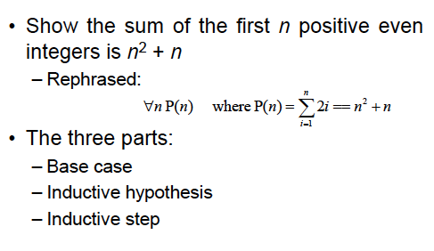
Example 2

Slide 10
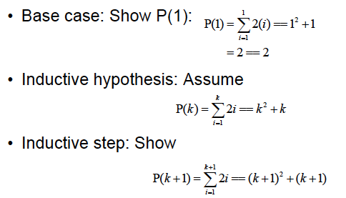
Example continued

Slide 11
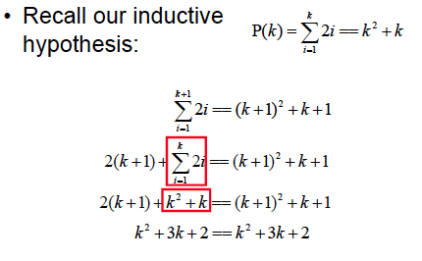
Example continued

Slide 12
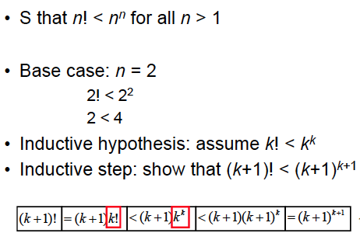
Example 3

Slide 13
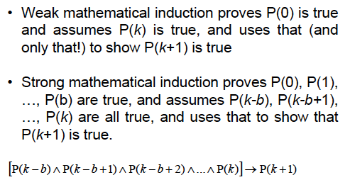
Strong induction

Slide 14
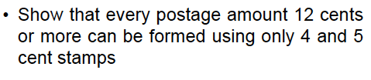
Example

Slide 15
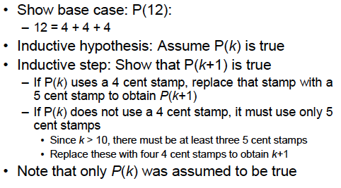
Proof using Mathematical Induction

Slide 16
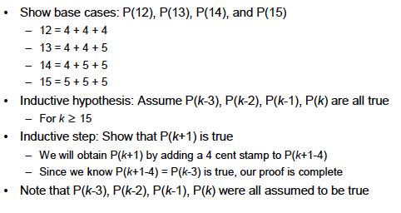
Same Proof using Strong Induction

Slide 17
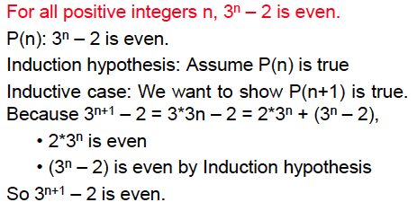
Errors in Induction
Question: What is wrong here?

Slide 18
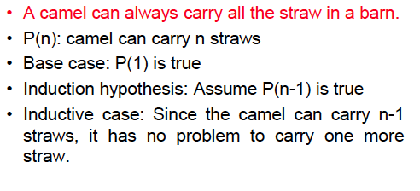
Errors in Induction
Question: What is wrong here?

Slide 19
Recursion
Recursion means defining something, such as a
function, in terms of itself
– For example, let f(x) = x!
– We can define f(x) as f(x) = x * f(x-1)

Slide 20


Recursive definition
Two parts of a recursive definition:
Base case and a Recursive step
.

Slide 21
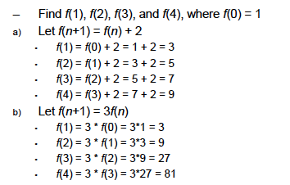
Recursion example

Slide 22
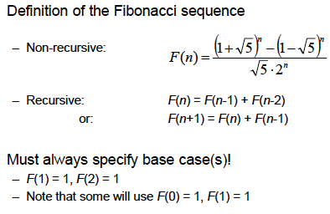
Fibonacci sequence

Slide 23
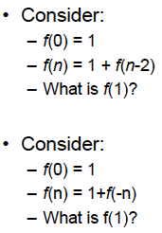
Bad recursive definitions
Why are these definitions bad?

Slide 24
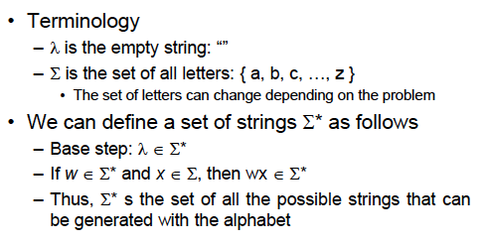
More examples of recursion: defining strings

Slide 25
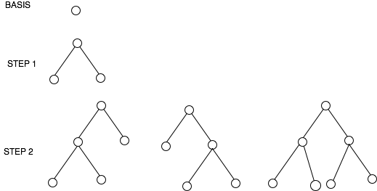
Recursive definition of a full binary tree
Basis. A single vertex is a full binary tree
Recursive step. If T1 and T2 are disjoint full binary trees, then a full
binary tree T1.T2 consisting of a root r and edges connecting r to each
of the roots of T1 and T2 is a full binary tree.

Slide 26
Recursive definition of the height of a full binary tree
Basis. The height full binary tree T consisting of only a root is h(T)= 0
Recursive step. If T1 and T2 are two full binary trees, then the full
binary tree T= T1.T2 has height h(T)= 1 + (max h(T1), h(T2)

Slide 27
Structural induction
A technique for proving a property of a recursively defined object.
It is very much like an inductive proof, except that in the inductive
step we try to show that if the statement holds for each of the
element used to construct the new element, then the result holds
for the new element too.
Example. Prove that if T is a full binary tree, and h(T) is the height of the tree
then the number of elements in the tree n(T) ≤ 2 ^{h(T)+1} -1.
See the textbook (pages 355-356) for a proof of it using structural induction.
We will work it out in the class.

Slide 28
Recursive Algorithm
Example 1. Given a and n, compute a^{n}
procedure power (a : real number, n: non-negative integer)
if n = 0 then power (a, n) := 1
else power (a, n) := a. power (a, n-1)

Slide 29
Recursive algorithms: Sorting
Here is the recursive algorithm Merge sort. It merges two sorted
Iists to produce a new sorted list
8 2 4 6 10 1 5 3
8 2 4 6
10 1 5 3
8 2
4 6
10 1
5 3

Slide 30
Mergesort
The merge algorithm “merges” two sorted lists
2 4 6 8 merged with 1 3 5 10 will produce 1 2 3 4 5 6 8 10
procedure mergesort (L = a₁, a₂, a₃, … a_{n})
if n > 0 then
m:= ⎣n/2⎦
L1 := a₁, a₂, a₃, … a_{m}
L2 := a_{m+1}, a_{m+2}, a_{m+3}, … a_{n}
L := merge (mergesort(L1), mergesort(L2))

Slide 31
Example of Mergesort
1 2 3 4 5 6 8 10
8 2 4 6 10 1 5 3
2 4 6 8
8 2 4 6
10 1 5 3
1 3 5 10
2 8
8 2
4 6
4 6
10 1
1 10
5 3
3 5

Slide 32
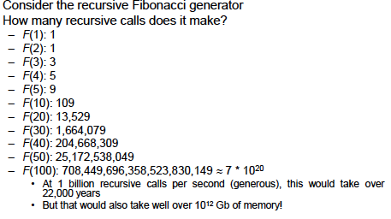
Pros and Cons of Recursion
While recursive definitions are easy to understand
Iterative solutions for Fibonacci sequence are much faster (see 316-317)

